Slide 1
Object Detection and Orientation (ODO) using Yolo v3 tiny
Author: Alex Strebeck

Slide 2
Objective
The object of this project is to train and refactor the Yolo computer vision model to detect a unique/ specific object.
Once the object is detected the algorithm will use properties of the detected object to calculate its orientation(i.e. in-plane rotation, scale, etc.)

Slide 3
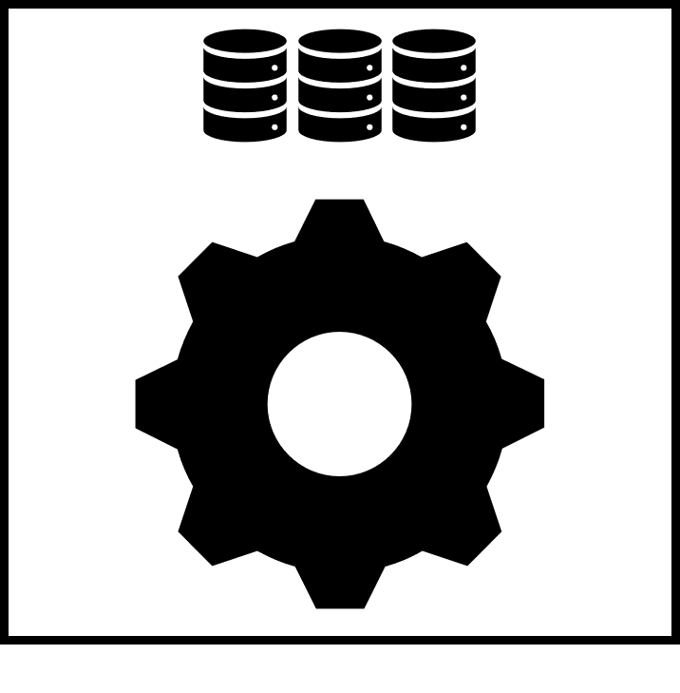
Methods
In order to begin the project a AI neural network had to be trained on a new data class that the user can control so that it is reproducible and deterministic. An example of the training class is show below.
Next, Individual classes of the gear and database images must be trained on. This is demonstrated on the example image.
Object
Data Base
Gear

Slide 4
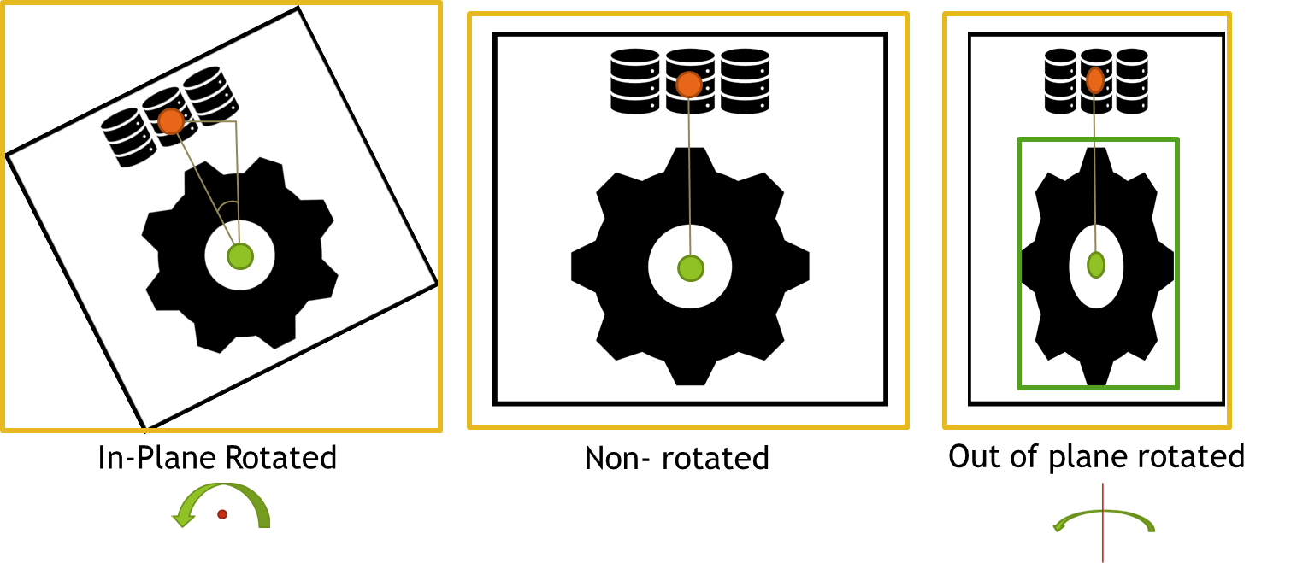
Methods continued
Once the objects have been detected and verified (i.e. they exist and have a high confidence) the following properties are calculated using the center points and bounding boxes of the classes detected. See below.
Center points are used with trigonometry to find the in plane rotated angle.
Gear width and height used to calculate out of plan rotation vertically and horizontally.
Object bounding box diagonal used for overall scaling

Slide 5
Darknet Yolo v3 tiny
To start the git repo of the darknet yolo models must be downloaded this also includes instruction on how to use it.
https://github.com/AlexeyAB/darknet
Once the repo is downloaded it must then be compiled using visual studio, preferably 2015.
The last step is to use the built in commands to test and train the model.

Slide 6
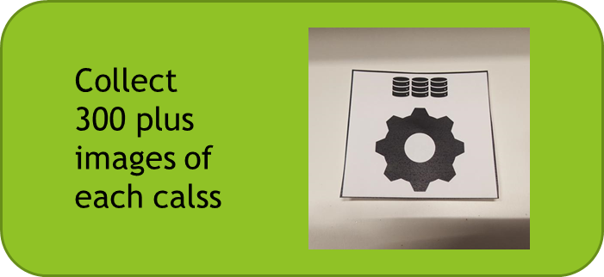
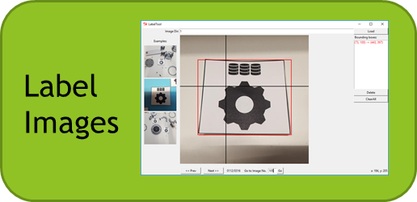
Training
When Darknet has been successfully compiled and verified to be working the training can begin.
Training for ODO was tedious and time consuming but serves as the initial training for the model. The quality of the bounding box labels determines how precise the predictions will be. The below diagram shows the training/labeling process which is repeated for each class (3 in this case).
Current training uses high confidence images as new training images both in a regular state as well as inverted to give the model new perspectives. This highly automates the training and labeling aspect.
X number of classes
Train on Images

Slide 7
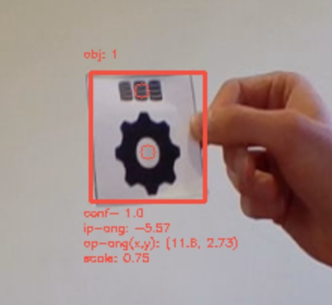
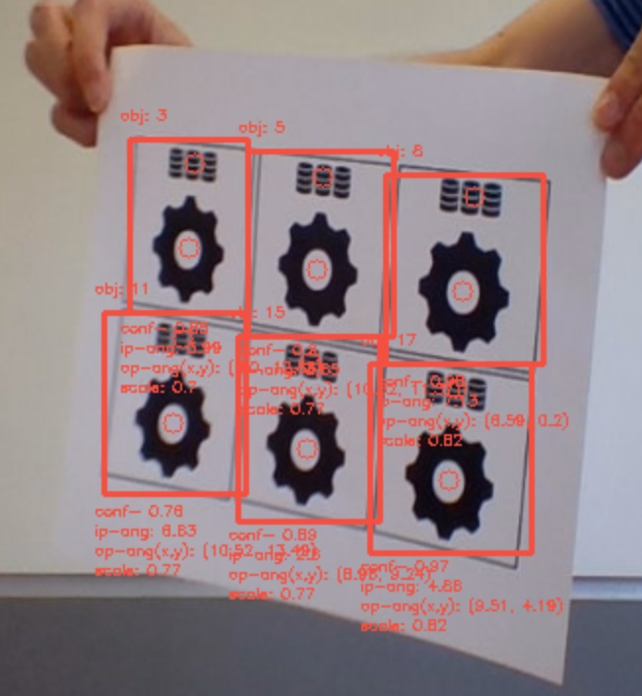
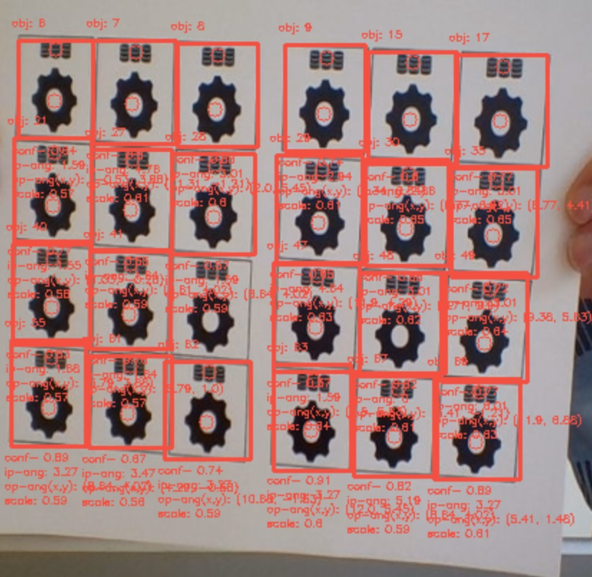
Results
The results of this demo projects were better than expected. The model is able to track the object easily. Additionally the algorithm is able to calculate the scale and in plane rotation well. As for the out of plane rotation, the results can be in proved (works about 50% of the time). The algorithm I also able to calculate many objects at once as seen in the example images below.

Slide 8
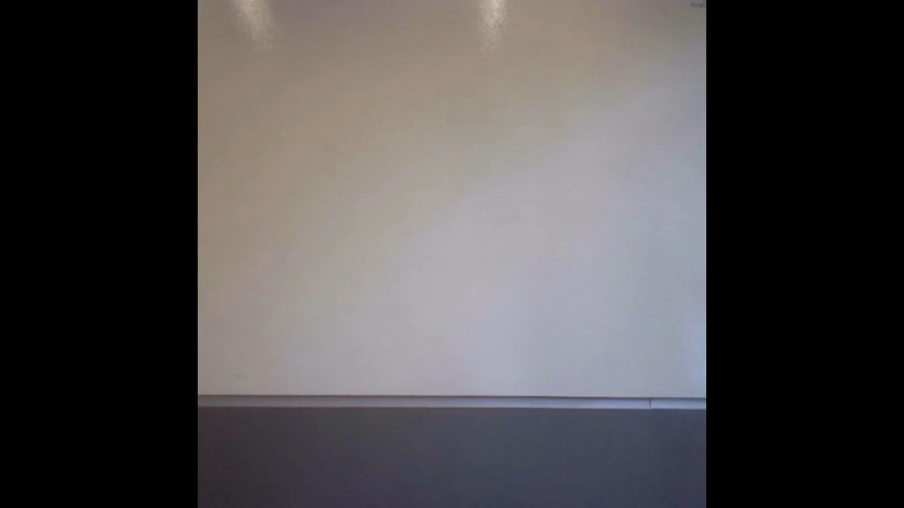
Demo

